Slide 1


Capacity Analysis and Improvement proposals for Secunderabad Station
Department of Civil and Industrial Engineering
Master’s Degree in Transport Systems Engineering
Candidate
Sai Arvind Atluri
1722524
Relator- Prof. Stefano Ricci

Slide 2
Index
Objective of study
Methodology
Introduction to the case study
Schematic Representation, Muller Figure
Capacity Analysis
Improvement Proposals

Slide 3
Objective of study
To determine how different factors affect stations capacity by means of a comprehensive analysis of the complex station.
Potthoff method is used for the evaluation of carrying capacity of complex railway nodes.
Train delays play an important role in capacity analysis.
Focused on average delays, average delay per train and the capacity utilization coefficients.
The timetable is of great importance in capacity analysis of structured railway operation.

Slide 4
Methodology
Four major stages:
Data collection,
Layout and geometry of the station and network representation,
Analysis method,
Performance measurements.

Slide 5
Introduction to case study
Indian Railways is the world’s fourth largest railway system. Founded in 19th century, this system serves millions of tourists and locals, every day.
Secunderabad station: located in the southern part of India and is considered for the analysis. It started operations on 9th October 1874.
One of the major junction stations of SCR (South-Central Railway) provided with 10 platforms. Estimated travellers and visitors is around 0.16 million per day.
Currently Secunderabad junction is planned to cater to different kinds of trains such as the following:
Long distance Intercity, Rajdhani (Connecting the capital states across India);
Less passenger density intercity train most of which terminate or originate at Secunderabad;
Special trains (Festive trains);
MMTS (Multi Modal Transport System) and suburban trains;
Mail Express trains ( Super Fast and less number of halts)

Slide 6
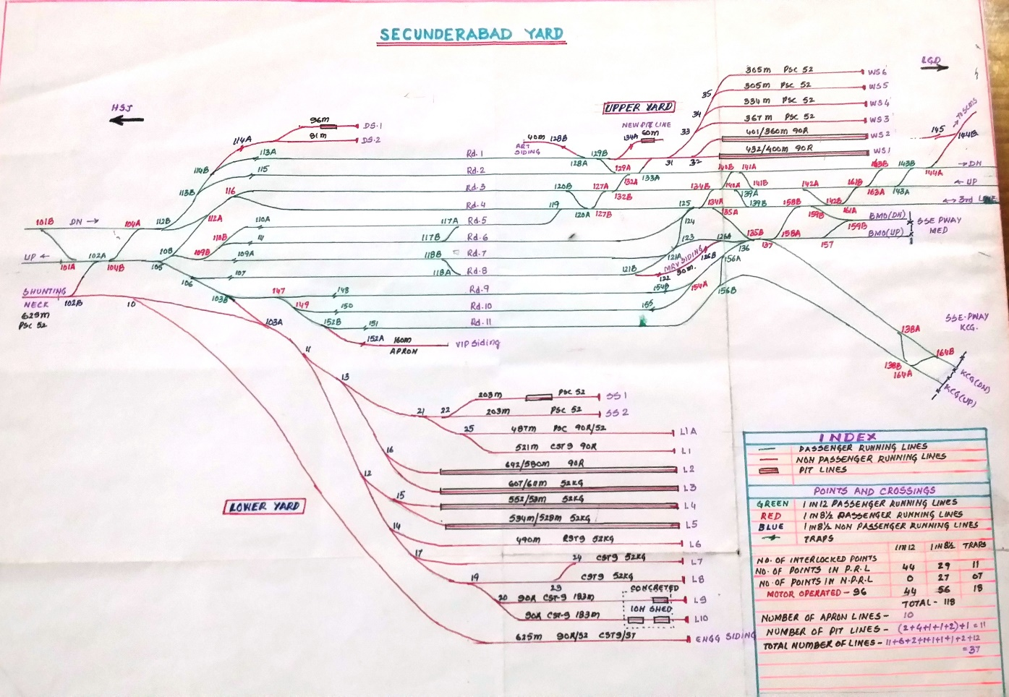
Schematic representation of Secunderabad station

Slide 7
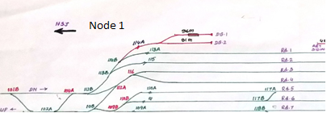


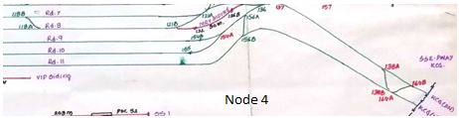
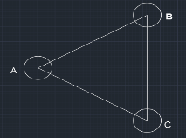
A | 15 |  | 1 | 15
B | 10 |  | 2 | 10
C | 16 |  | 3 | 16
D | 35 |  | 4 | 35
E | 6 |  | 5 | 6
F | 14 |  | 6 | 14
G | 17 |  | 7 | 17
H | No Stopping |  | 8 | 9
I | 9 |  | 9 | 10
J | 10 |  | 10 | 26
K | 26
Nodes | Traffic flow
Node -1 | 54
Node -2 | 33
Node -3 | 32
Node -4 | 28

Slide 8
Capacity check procedure

Slide 9
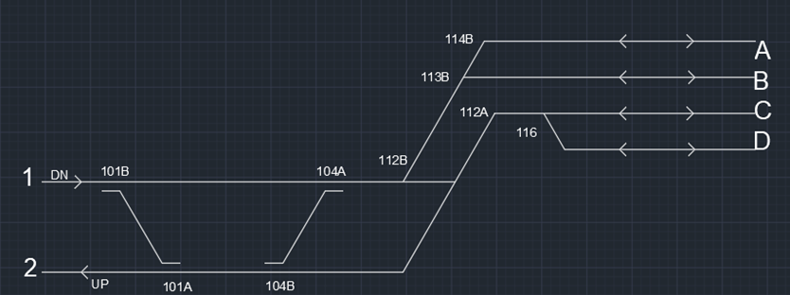
Capacity analysis of node 1
 | 1-A | 1-B | 1-C | 1-D | A-2 | B-2 | C-2 | D-2
1-A | A | S | S | S | Z | Z | . | .
1-B |  | A | S | S | Z | Z | . | .
1-C |  |  | A | S | X | X | Z | Z
1-D |  |  |  | A | X | X | Z | Z
A-2 |  |  |  |  | A | Z | Z | Z
B-2 |  |  |  |  |  | A | Z | Z
C-2 |  |  |  |  |  |  | A | Z
D-2 |  |  |  |  |  |  |  | A
X – intersection of routes;
A – between a route and itself; Z – converging routes; S – diverging routes D – consecutive following routes;
U – frontal routes.
average number of trips
n_{m} = | N*N
 | ƩNiNj
n_{m} = | 1
average occupation time
Path i | 1-A | 1-B | 1-C | 1-D | A-2 | B-2 | C-2 | D-2
N | 8 | 4 | 2 | 32 | 1 | 1 | 4 | 2
t̅ = | ƩNiNjTij
 | ƩNiNj
t̅ = | 4.94 min
total delay considering simultaneous movements of n_{m} trains
total occupation time
regular utilization coefficient
global utilization coefficient
ƩRij
n_{m}
28.12 min
B = | N t̅
 | n_{m}
B = | 266.7441
Ur = | B
 | T
Ur = | 0.185239
Ut = | B + ƩRij
 | n̅
 | T
Ut = | 0.204764

Slide 10
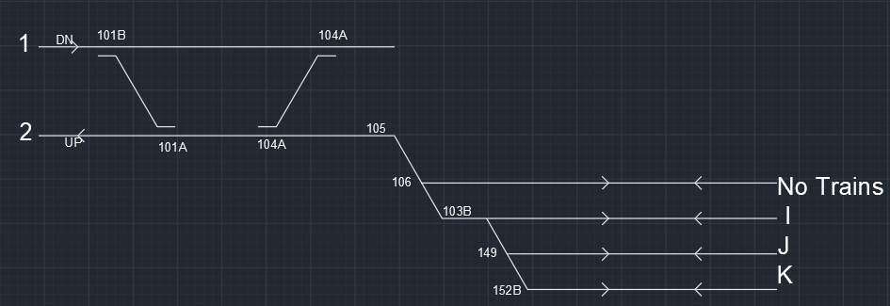
Capacity analysis of node 2
 | 1-I | 1-J | 1-K | I-2 | J-2 | K-2
1-I | A | S | S | Z | Z | Z
1-J |  | A | S | X | Z | Z
1-K |  |  | A | X | X | Z
I-2 |  |  |  | A | Z | Z
J-2 |  |  |  |  | A | Z
K-2 |  |  |  |  |  | A
average number of trips
n_{m} = | N*N
 | ƩNiNj
n_{m} = | 1
Path i | 1-I | 1-J | 1-K | I-2 | J-2 | K-2
N | 1 | 2 | 2 | 2 | 4 | 22
From the graph,
average occupation time
total delay considering simultaneous movements of n̅ trains
total occupation time
t̅ = | ƩNiNjTij
 | ƩNiNj
t̅ = | 3.93 min
ƩRij
n_{m}
6.15 min
B = | N t̅
 | n_{m}
B = | 129.6126
regular utilization coefficient
global utilization coefficient
Ur = | B
 | T
Ur = | 0.090009
Ut = | B + ƩRij
 | n_{m}
 | T
Ut = | 0.094281

Slide 11
Step -1 Utilization coefficient vs. number of movements
In the step 1, an analysis of utilization coefficient vs. number of movements is taken by increasing the number of trains at regular intervals of 32 units
From the graph, utilization coefficient is increasing as the number of movements of the trains is increasing
Total number of movements (N) | Regular utilization coefficient (U_{r}) | Global utilization coefficient (U_{t})
54 | 0.18 | 0.20
86 | 0.27 | 0.31
118 | 0.35 | 0.43
150 | 0.44 | 0.57
182 | 0.53 | 0.71
214 | 0.62 | 0.87

Slide 12
Step -2 Average delay per train vs number of movements
In step 2, the average delay per train is calculated using the equation ƩR_{ij} / N
Where:
R_{ij} is the average delay;
N is the Number of movements.
From the graph, average delay per train is increasing as the number of movements of the trains is increasing.
ƩR_{ij} [min] | N [trains] | ƩR_{ij} / N [min/train]
28.12 | 54 | 0.52
63.24 | 86 | 0.73
113.50 | 118 | 0.96
178.92 | 150 | 1.19
259.47 | 182 | 1.42
355.17 | 214 | 1.66

Slide 13
Proposals to improve and enhance station functioning
Graph 1 Graph 2
In the hypothesis the maximum total utilization rate is 75.
The corresponding maximum number of movements is 189 (Black line)
Therefore, we conclude that the maximum number of movements the station can manage for node 1 is 189.
From graph 1 we consider the maximum number of movements is 189 and the corresponding average delay per train is 1.48 minutes (Yellow line)

Slide 14
Thank you!

